Slide 1


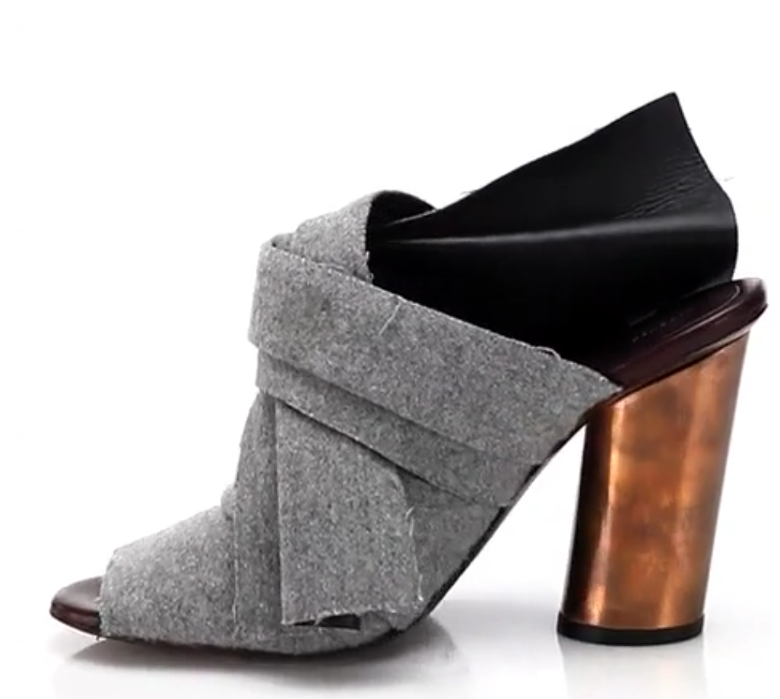
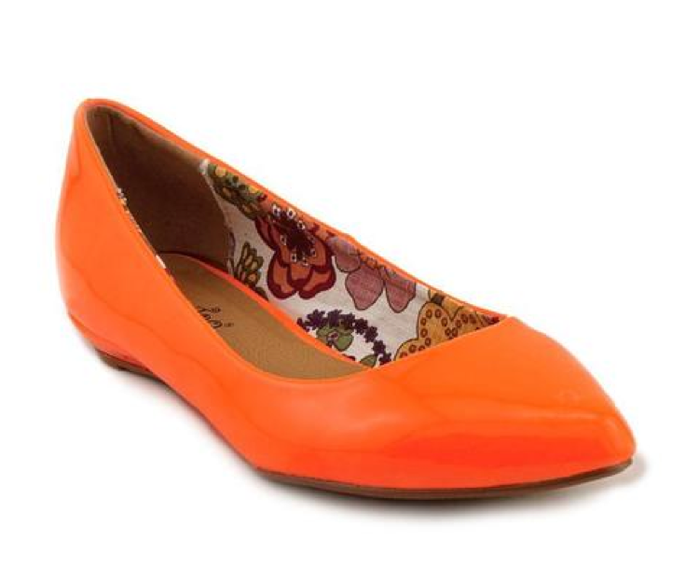
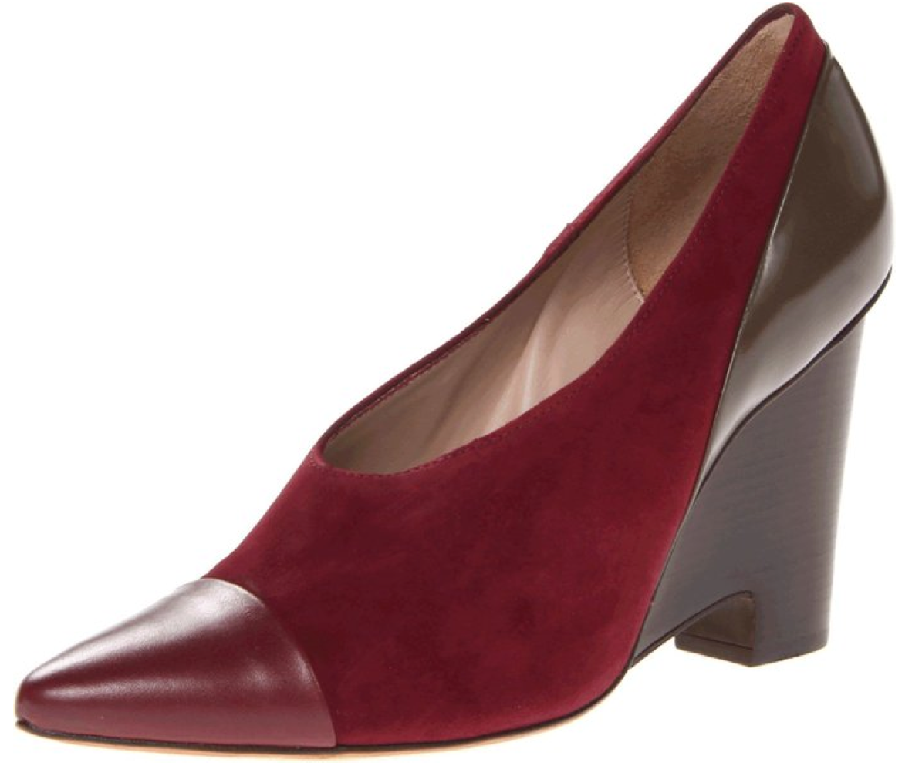
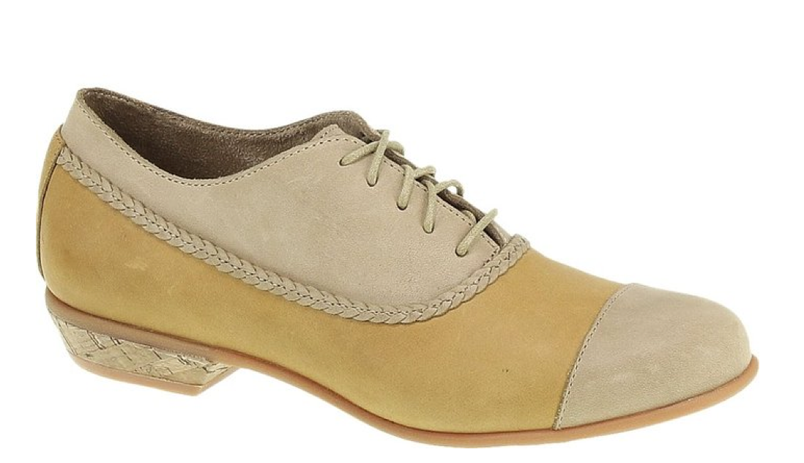
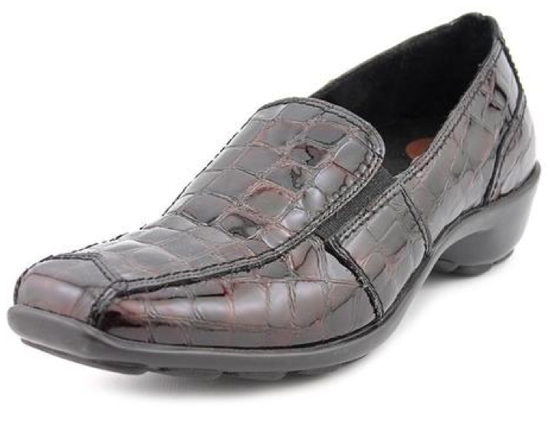
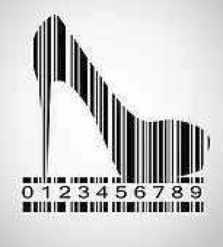
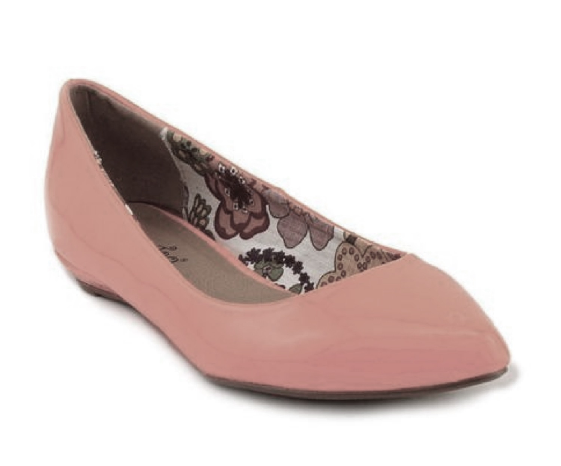
Shoes
Merchants
A typical end user
Women’s Shoes
Men’s Shoes
…
Girl’s Shoes
y₁
y₂
y₃
y₄
y_{L}
Comfort
Pumps
Sneakers
Flats
…
Lyza Clog
Lyza Clog is unavailable
100MM Runway
Felt Mule Sandals
Lips Too Women's
'Too Sliver' Patent
Casual Shoes
Size 6
1883 by Wolverine Women's Maisie Oxford Tan/Taupe Leather/Suede
1803 Women's 'Nome' Crocodile Dress Shoes Size
9
10 Crosby Women's
Ynez Pump
More Women’s Comfort Shoes
x₃
100MM Runway
Felt Mule Sandals
x₂
x₆
…
x_{N}
x₁
x₄
Lips Too Women's
Casual Shoes
Machine Learning
Model
Learn: Y=
(X)

Slide 2
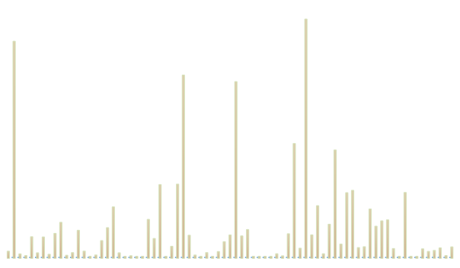
Notes:
Dec 2015

Slide 3
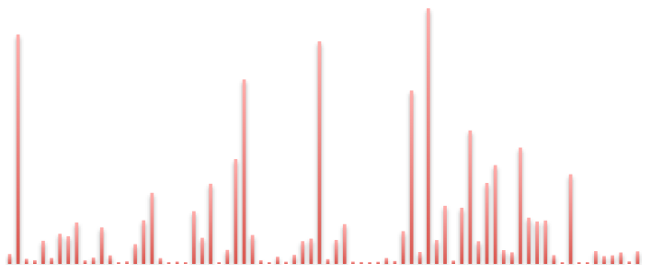
Notes:
Feb 2016

Slide 4
Notes:
Shoes problem: L1 on Dec 2015 data

Slide 5
Notes:
Slice dataset stats

Slide 6
Notes:
AmazonJ

Slide 8
Dec
2015
Feb
2016

Slide 9
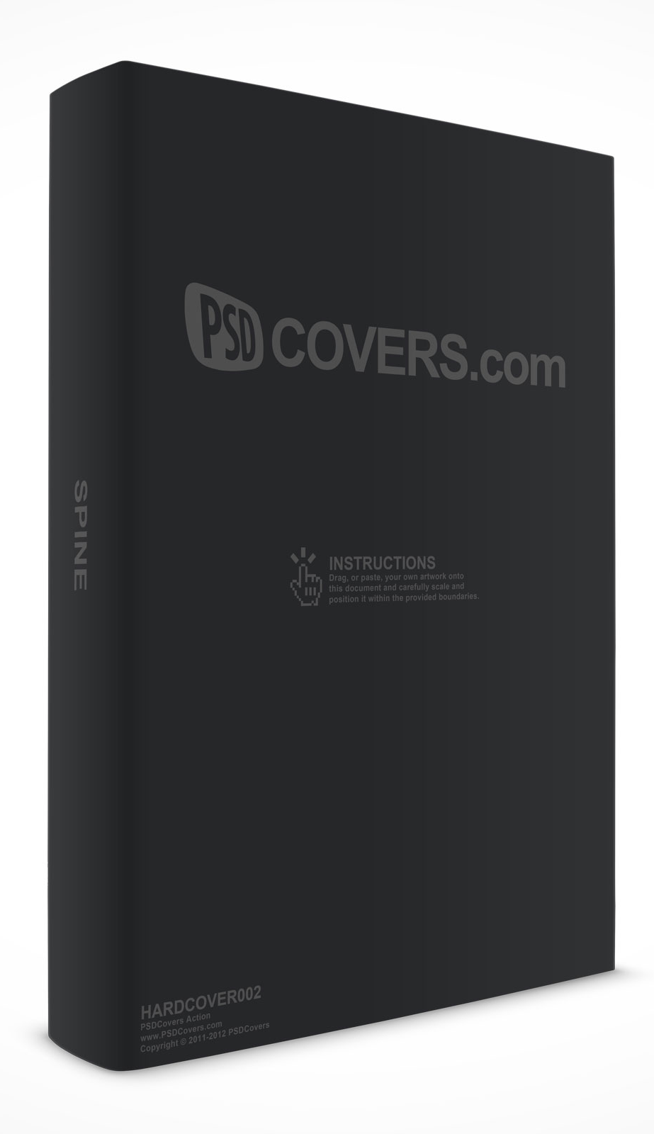
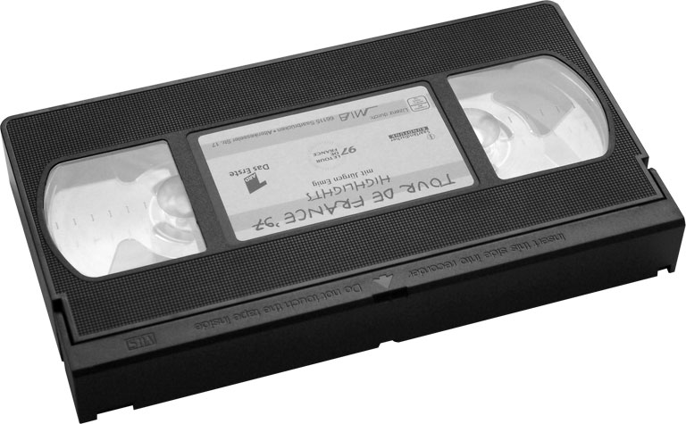

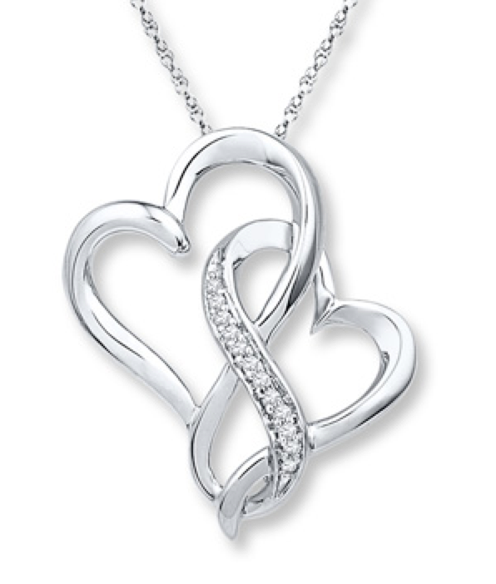
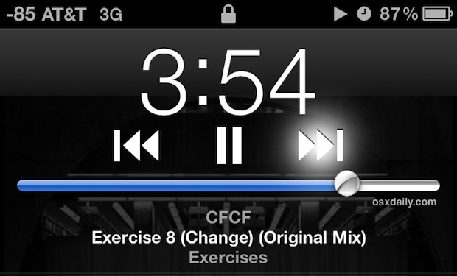


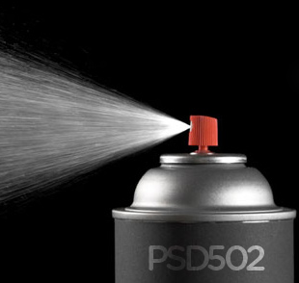
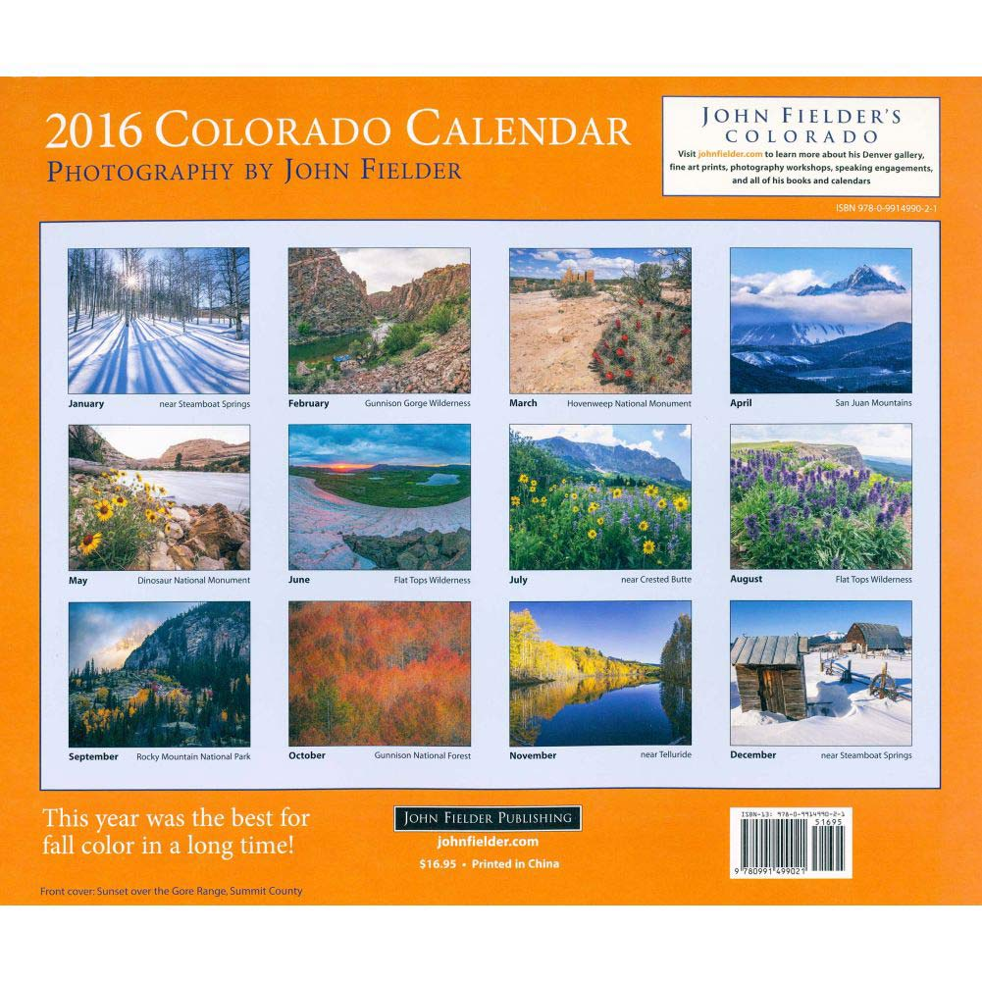
hardcover guide design handbook international health business social law science english
vhs world series time king war ball house trek christmas space dog circle
license standard symantec system service cisco support year essential years package upgrade
heart diamond pearl 40 ring sterling chain charm 39 14k 47 bracelet watch stainless pendant
i c love day e night u single lady child woman uk good deluxe park
dvd jazz media mixed country artists vol play music product pop ed import john complete club
paperback book history god home und soul stories journey bible der die code people
set 20 100 24 case kit oz 30 hand drive body wall digital ft 48 spray paper liquid mount gift
de calendar la american disc el 2013 art 2009 ray 2012 compact america great 2010
Notes:
Suspicious latent topics

Slide 10
oxford burgundy plain espresso wing madison | Oxfords > Men’s Shoes > Shoes | Conf: 36.91
pr boots work mens blk composite | Boots > Men’s Shoes > Shoes | Conf: 44.4
sneaker low top perforated marc neck | Boots > Girl’s Shoes > Kids & Baby Shoes > Shoes | Conf: 43.29
tan polyurethane life saddle stride bed | Flats > Women’s Shoes > Shoes | Conf: 29.48
13 reaction york ak driving steven | Sneakers & Athletic Shoes > Men’s Shoes > Shoes | Conf: 53.92
original rose bone mark lizard copper | Climbing > Men’s Shoes > Shoes | Conf: 57.21
Notes:
3, 5 and 6 are suspects

Slide 11
Category | Product title
data storage > computers > electronics & accessories | 120gb hd 5400rpm sata fdb 2 5 mobile
laptops & netbooks > computers > electronics & accessories | acer aspire v7 582pg 6421 touchscreen ultrabook 15 6 full hd intel i5 4200u 8gb ram 1tb hdd 20gb ssd nvidia geforce gt 720m
First half of the title

